Slide 1
Game test

Slide 2
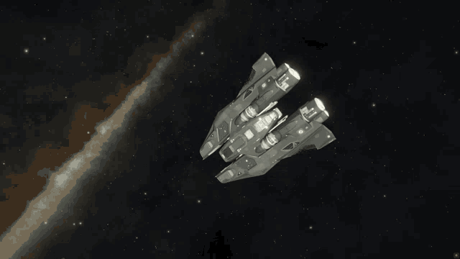
Important bits up front
Controls like in E:D
That means:
  W/S Forward/Back
  Q/E Left/Right
  R/F Up/Down
  A/D is either Yaw or Roll (Set it up)
  Remaining of Pitch/Yaw/Roll on mouse, OR with KB-only controls, on I/K and J/L
Backspace will restart a level, Escape brings you back to the menu.
How to play?
  You can fly in the flight test to test the handling (Including a handy obstacle field)
  Or try the prototype level (Pass through all the checkpoint rings that have the translucent barrier and into the finish!)
  Try the different control options! Ask if it‘s unclear (They are mostly internal names for now)

Slide 3
What am I looking for?
Anything you think about really
But, most valuable would be:
  Ship handling (Does it slide too much? Is the acceleration too slow?
  Scale (Are the checkpoints too small? Does the ship often get snagged on the checkpoint sides?)
  What UI are you missing? Pointers to the next checkpoint maybe? Centre-of-screen dot? Can you tell which way the ship is going to rotate via mouse controls?
  Did you get lost in any way?
  Is the color scheme OK and if not, what was hard to see?
If you wanted a feature to make the game feel nicer, what would it be?
  Music?
  Dynamic camera so it feels like first pirson instead of a camera maybe?
  Time splits?
  Or a hotkey for some control function?

Slide 4
Thanks for the help!

